Slide 1
Title & Introduction
Title: Salary Prediction with watsonx.ai: A Data-Driven Approach
Subtitle: Unlocking Workforce Insights with Machine Learning
Key Question: How can AI help us understand and predict salaries?
Our Approach: Building a robust salary prediction model using Salary_Data.csv and leveraging IBM watsonx.ai for development and deployment.
Presenter: Shubhanshu Singh
Date: August 2, 2025

Slide 2
Project Overview & Data Foundation
Why Salary Prediction?
For Organizations: Informed compensation, competitive hiring, budgeting.
For Individuals: Career planning, market value assessment.
Our Dataset: Salary_Data.csv
Features: Age, Gender, Education Level, Job Title, Years of Experience.
Target: Salary (continuous numerical value).
Scale: 6698 records (after dropping missing values).
Leveraging watsonx.ai in IBM Cloud:
Watson Studio: Collaborative environment for data science (Jupyter Notebooks used for model building).
Watson Machine Learning: Platform for model training and deployment.
(Visual Suggestion: A small table or screenshot showing a snippet of the Salary_Data.csv head

Slide 3
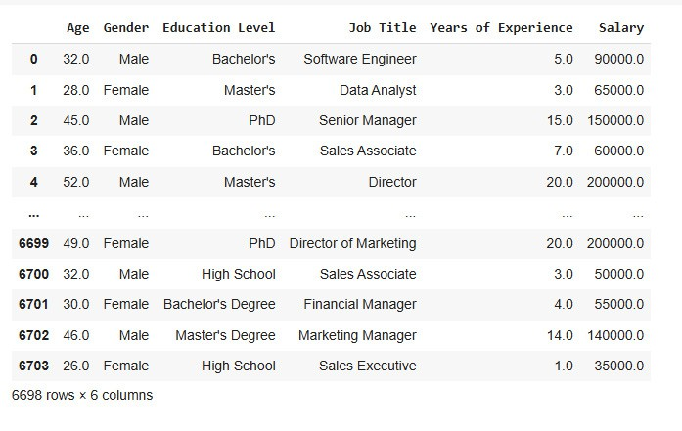

Slide 4
Data Preparation & Model Building
Data Preparation Pipeline:
Missing Values: Rows with nulls were removed.
Categorical Encoding: Label Encoder converted 'Gender', 'Education Level', and 'Job Title' into numerical formats.
Data Split: Dataset divided into 80% training and 20% testing sets.
Feature Scaling: Standard Scaler applied to standardize numerical features, optimizing model performance.
Model Selection: Random Forest Regressor
Why? An ensemble method known for high accuracy and robustness in handling diverse datasets and complex relationships.
Configuration: 100 decision trees (n_estimators=100).
Training: Model trained on the prepared data within Watson Studio's Jupyter Notebook.

Slide 5
Model Performance & Insights
Evaluation Metrics:
Root Mean Squared Error (RMSE): Measures average prediction error.
Result: $8357.21
R-squared (R2 Score): Explains variance in target variable (0-1, higher is better).
Result: 0.98
Interpretation:
An R2 of 0.98 indicates the model explains 98% of the variance in salary, demonstrating strong predictive power.
The low RMSE signifies predictions are, on average, close to actual salaries.

Slide 6
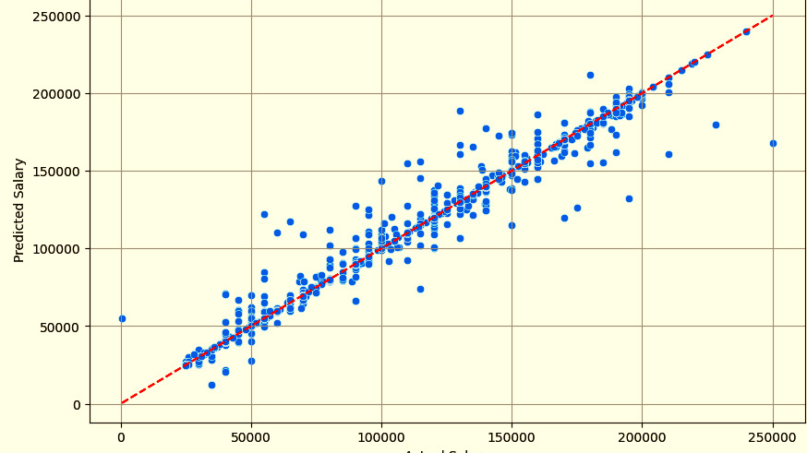
Actual vs. Predicted Salary Plot:
The scatter plot illustrates a tight cluster of points around the ideal prediction line, confirming the model's accuracy visually.
(Visual Suggestion: Insert the "Actual vs Predicted Salary using Random Forest" scatter plot from your Jupyter Notebook here.)

Slide 7
Conclusion & Next Steps
Key Achievement: Successfully built a highly accurate salary prediction model that can provide valuable compensation insights.
IBM Cloud & watsonx.ai Advantage: Provided the necessary tools and scalable environment for eﬃcient development and potential deployment.
Future Enhancements:
Deployment: Deploy the model via Watson Machine Learning for real-time API access.
Feature Engineering: Incorporate additional data points (e.g., specific skills, company size) for greater precision.
Continuous Monitoring: Implement MLOps practices using Watson OpenScale to track performance, detect data drift and ensure fairness.

Slide 8
Thank You!

